Slide 1
HEALTH 2012
PREVENT
THE RISKS OF MUSCULOSKELETAL DISORDERS
YOU ONLY HAVE ONE LIFE. KEEP IT HEALTHY!
Notes:
It is a well-known fact that physical activity is good for one’s health.
Working generates physical activity.
Unfortunately, sometimes certain work conditions and postures can be detrimental to one’s health.
It is therefore necessary to work ergonomically, that is to say, respecting the natural curves of the body and assuming the least tiring and constraining positions possible.
If you do not pay attention to your work posture, in the long term, you run the risk of suffering the onset of MSDs
What do musculoskeletal disorders mean to you?
[Make staff participate before proceeding with the next slide]

Slide 2
The definition of musculoskeletal disorders
Disorders
Musculo
Skeletal
Diseases affecting the muscles, tendons and nerves of the limbs and spinal column.
Expressed by:
pain
stiffness
awkwardness
loss of strength
Ailment / pain
Muscle / ligament / tendon
Joint / bone
Symptoms:
muscular fatigue
feeling of heaviness, discomfort, aches
problems with the functioning of muscle fibre
Notes:
Disorder means: complaints/pains/diseases.
Musculo means: : muscles/ligaments/tendons/nerves of the limbs.
Skeletal means: joint/bone/spinal column.
Musculoskeletal disorders are therefore pains that affect the muscles, tendons, nerves of the limbs, joints and spinal column.
This is expressed through pains, stiffness, awkwardness and loss of strength.
They trigger functional deficiencies that hinder professional activity.

Slide 3
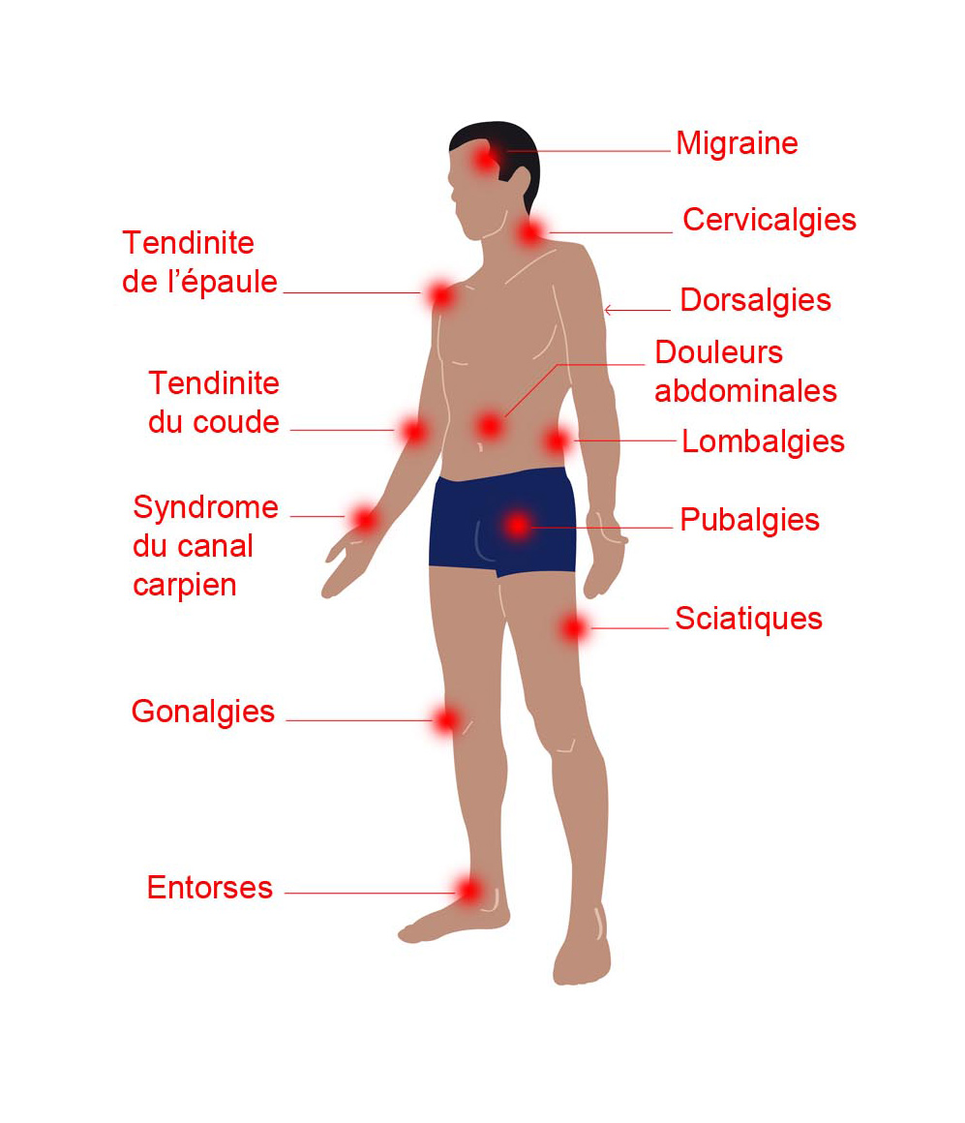
Location of musculoskeletal disorders
Migraine
Neck pain
6%
14%
Shoulder tendonitis
Back pain
Elbow tendonitis
Abdominal pain
Lower back pain
38%
Carpal tunnel syndrome
Pubic pain
10%
Sciatica
10%
Gonalgia
6%
Sprains
Notes:
Musculoskeletal disorders mainly affect the muscles, tendons and nerves of the upper and lower limbs at the level of the wrist, shoulders, elbow or knees. All parts of the body can be affected.
The most frequent location is the back. Lower back pain accounts for approximately 38% of the musculoskeletal disorders reported.
This may result from activities such as carrying heavy loads, repeated actions, standing at a station for long periods or seated at station for long periods of time.
The second most affected area is the shoulder. Shoulder tendonitis accounts for 14% of the musculoskeletal disorders reported.
This may result from activities such as repeated movements of the arms, working with the arms elevated, use of muscular strength (carrying loads, screwing/unscrewing).
The third complaint is in the wrists (with carpal tunnel syndrome) and the knees (knee pain = inflammation in the knees).
These complaints manifest themselves through pains and discomfort when moving around, in both the professional and private life.

Slide 4
Some statistics
1 employee out of 10 carries loads more than 10h/week
1 employee out of 10 repeats the same movements at a high speed and for more than 10h/week
2 employees out of 10 work almost 2h/week in difficult positions (arms in the air, on the knees, twisting, squatting)
5 employees out of 10 experience at least one heavy postural or joint constraint
40% of musculoskeletal disorders leave after effects (permanent or partial disability)
Notes:
Musculoskeletal disorders can affect different parts of the body, but also different types of people, whether construction staff or office staff. At one time or another, we have all had a heavy object to lift, a high object to reach, a working position that will be maintained.
A seated or standing work posture, if sustained for too long, can become restrictive (even sitting on our sofa, for those who spend 4h without moving a millimetre).
1 employee out of 10 carries loads more than 10 hours per week.
1 employee out of 10 repeats the same movements at a high speed and for more than 10 hour per week.
2 employees out of 10 work almost 2 hours per week in difficult positions (arms in the air, on the knees, twisting, squatting).
5 employees out of 10 experience at least one heavy postural or joint constraint.
On average, approximately 40% of musculoskeletal disorders can leave after effects, such as recurring pain or loss in range of movement.

Slide 5
Multiple factors of the onset of musculoskeletal disorders
Musculoskeletal load
Individual characteristics
Psychological and social factors
and/or
and/or
Probability of the onset of musculoskeletal disorders
Notes:
Musculoskeletal disorders are due mainly to physical constraints (carrying heavy loads, repetition…).
However, musculoskeletal disorders are in fact multifactorial diseases with professional elements, that is to say, these problems are due to several factors.
It is the combination of several criteria that can trigger the onset of musculoskeletal disorders.
Among these criteria, the most widely known is musculoskeletal load, be it work activity, position and environment, demands on the muscles, bones and joints. It is physical exertion.
The second is the individual himself since he has individual characteristics that are unique to him such as age, gender, physical strength, size; but work organisation and range of decisions are also factors.
The third and least known criterion groups the psychological and social factors, wellbeing at work, the work environment and harmony there, the social climate, conditions and professional recognition.
We see a bit more of these 3 criteria in the triggering of musculoskeletal disorders.

Slide 6
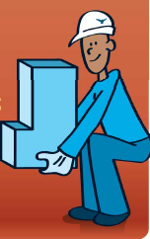
Trigger of musculoskeletal disorders (1)
Job position and environment
Repetition of the same movements
Work that does not involve much movement/standing at station for long periods
Handling of heavy loads
Exposure to vibrations
Work in the cold/draught
Postural constraints
Stretched arms
Squatting
On the knees
Bent over, twisted torso
Notes:
The most widely known criterion for musculoskeletal disorders is musculoskeletal load. It is linked to work activity, position and environment.
Included among the other triggering factors we have:
Repetition of the same movement: screwing, unscrewing for several hours non-stop, every day.
Work that does not involve much movement: office work.
Standing at a station for long periods, often standing still (eg. electrical wiremen).
Handling heavy loads (eg. a storekeeper).
Vibrations: vibrating tools such as drills/screw guns (for the arms) or forklifts (for the chest) with 2 to 4 consecutive hours of exposure, or more.
Working in the cold and in a draught (eg. hostess, delivery people, employees working in warehouses).
Postural constraints (eg. electricians, wiremen, mainly technicians at construction sites and workshops).

Slide 7
Trigger of musculoskeletal disorders (2)
Organisation of work
Extremely short deadlines
Heavy work load
Monotonous work
Imposed pace
Notes:
Just as the work conditions and the type of task to be performed, organisation and range of decisions are also important.
Extremely short deadlines will cause the operator to feel nervous and stressed since he would like to complete his work within the timeframe established.
A heavy work load will require an increase in performance, therefore implicitly, an increase in the speed with which work is carried out and a rise in physical demand (of the body).Quite often, the work pace will be imposed.
Monotonous work does not mean slow, but boring and redundant, work that is considered by the operator to be lacking in interest.
Added to that can be the lack of recovery, night work and short rest periods.

Slide 8
Trigger of musculoskeletal disorders (3)
Psychological and social factors (social climate)
Poor working relationship
Lack of mutual support among colleagues
Stressful situation
Notes:
The last criterion for onset is also the most difficult to identify and control.
It is the social factors of the company, the individual factors of the person and their interaction.
The company organises its operations in relation to the objectives that it has established.
Unfortunately, sometimes the expectations of the company and those of the employees do not match.
The employee can therefore have the impression that his physical and mental resources are not enough in light of the expectations of the company.
There is an imbalance between the demand and the psychological feasibility.
The psychological factors are individual and changing elements.
This is the non-quantifiable information, it is a personal feeling.
Two individuals facing the same problem will not react in the same way.
The most common psychological and social factors are:
Poor working relationship.
Lack of mutual support among colleagues.
Stressful situation.
All of these elements are also factors that stem from anxiety at work and can trigger the onset of musculoskeletal disorders.

Slide 9
Ideas received on prevention
Working seated, it is better to work standing!
To reduce the risk of musculoskeletal disorders, it is necessary to keep changing positions and staying flexible!
It is better to assign difficult positions to young people. They are more resilient!
TRUE
and
FALSE
Notes:
Working seated, it is better to work standing. True and false!
The task determines the work position.
Changing position to suit your pace reduces the fatigue of a posture that is maintained for an extremely long period of time.
To reduce the risk of musculoskeletal disorders, it is necessary to keep changing positions and staying flexible. True and false!
When work is carried out consecutively, changing positions in the same work day avoids monotony, excessive repetition of movements and allows for the sound management of joint and muscular constraints.
In that sense, it reduces the risk of musculoskeletal disorders.
Flexibility is one way of ensuring the diversification of tasks during the course of the day, of a work week, etc.
In that sense, it helps to manage the physical constraints that can give rise to musculoskeletal disorders.
That is only true if it is accompanied by adequate training and if it allows the different muscle groups to be worked.
Moreover, exposing several people to musculoskeletal disorders is not a solution either.
It is better to assign difficult positions to young people. They are more resilient. True and false!
Their muscular capacity is certainly often superior to that of seniors, but it does not protect them that much from the risks of musculoskeletal disorders. If seniors are more vulnerable, their experience allows them to develop strategies to safeguard their health. In all cases, reducing difficulties is the first stage toward reducing the risk factors of musculoskeletal disorders and it must be applied to all employees.

Slide 10
At organisational level
PREVENTION
Prevention is better than cure!
Ignore the onset of early symptoms to consider ergonomics in the job position
Choose work equipment with input from employees (1st user = 1st affected)
Design of the work place: adjusted layout and sizing, physical environment (noise, vibration, temperature, air flow)
Notes:
Organisation of work is one of the keys to avoiding the onset of musculoskeletal disorders.
Quite often, since they are accustomed to their knowledge and their personal feeling, operators have the reflex to adjust their position.
For example, the use of a reel (in the absence of steps) so as to avoid working with stretched arms and/or arms over the head.
The work space can be equipped with tools in good working condition that are useful and can be accessed quickly (eg. electric machines instead of hand machines, use of ergonomic foam sheets on protruding parts).

Slide 11
At group level
PREVENTION
Favour the use of handling equipment instead of human strength
Screw gun instead of screwdrivers
Forklift or pallet jack instead of arm strength
Hoist instead of human strength
Hydraulic wrenches in place of striking wrenches
Anticipate and maintain the material and tools suited for the task
Use mechanical force instead of human strength!
Notes:
Favour the use of handling material and tools that are placed at your disposal so as to make fewer demands on your body.
By forcing our bodies too much, the resources become depleted, and if the resources decrease, the body becomes weaker.
All the means attached for relieving our body from constraints are good to be employed, such as:
Screw guns.
Forklifts.
Hoists.
Hammers.
It is also necessary to maintain this material because it is as useful to you as it is to your colleagues.

Slide 12
At individual level
PREVENTION
Think before you act!
Optimise trips
Adequately distribute and reduce loads
You know your job position best, you are in the best position
to propose improvements
Maintain individual skills and knowledge: specific complementary training (eg. load carrying), awareness, welcoming new arrivals
In the case where you are doubtful about your safety, do not hesitate to seek advice from your superior or from HSEs!
Notes:
It will never be said enough, think before you act.
It is by anticipating your work that you will work best. It allows you to be organised.
For example, by optimising trips, by dropping off or going to look for several things at the same time and by distributing weight based on the number of trips.
Each of you knows your job and the tasks to be accomplished best. You are therefore in the best position to know where there is a concern and to propose improvements.
The books containing lists of faults also serve this purpose. Do not hesitate to bring up the problems that you have identified and to propose corrective actions.
Prevention also comes through knowledge. How can you safeguard yourself against something that you don’t know?
It is for that reason that awareness efforts are proposed to you regularly so that you can discover or deepen your knowledge. You can also request individual training so as to better understand certain risks and protect yourself.
You can also consult your physician if the constant pain that make it uncomfortable for you to work persist.

Slide 13
At personal level
PREVENTION
Engage in a physical activity
30 min/day
Vary the type of activity in order to develop the muscles throughout the entire body
Have a varied and balanced diet
Drink water (and few sugary drinks)
Avoid excessive coffee, tea and energy drinks
Reduce alcohol consumption
Reduce or stop smoking
A good lifestyle every day = Good health always
Notes:
The prevention of risks comes inevitably through the sphere of personal life.
Regular physical activity is essential. It allows you to maintain your muscle structure and to suffer fewer physical burdens.
It is also a good way to relieve stress.
Similarly, having a varied and balanced diet allows you to absorb all the nutrients, vitamins and proteins necessary for your body’s balance.
Good hydration, especially with heat or physical exertion, is essential in order to eliminate toxins.
Avoid alcohol that does not quench your thirst and does not satisfy your urge to drink. Also, avoid excessive amounts of coffee, tea and energy drinks since they over-stimulate the heart.
Tobacco must be limited since it reduces the body’s physical capabilities and endurance.
Take care of your body every day!

Slide 14
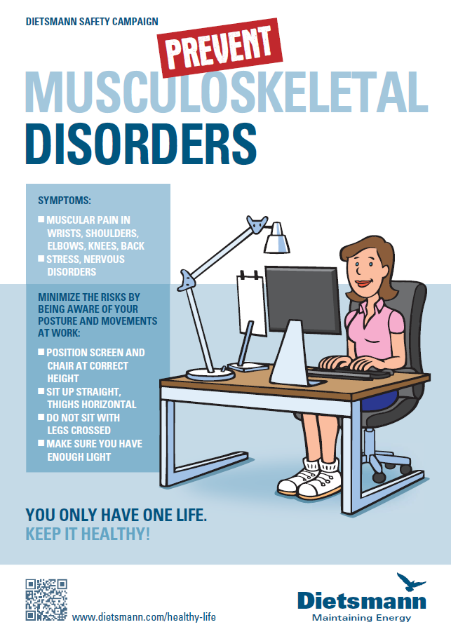
YOU ONLY HAVE ONE LIFE.
KEEP IT HEALTHY!

